Slide 1
2022 Smyrna Citizens Academy Graduation
May 16, 2022

Slide 2
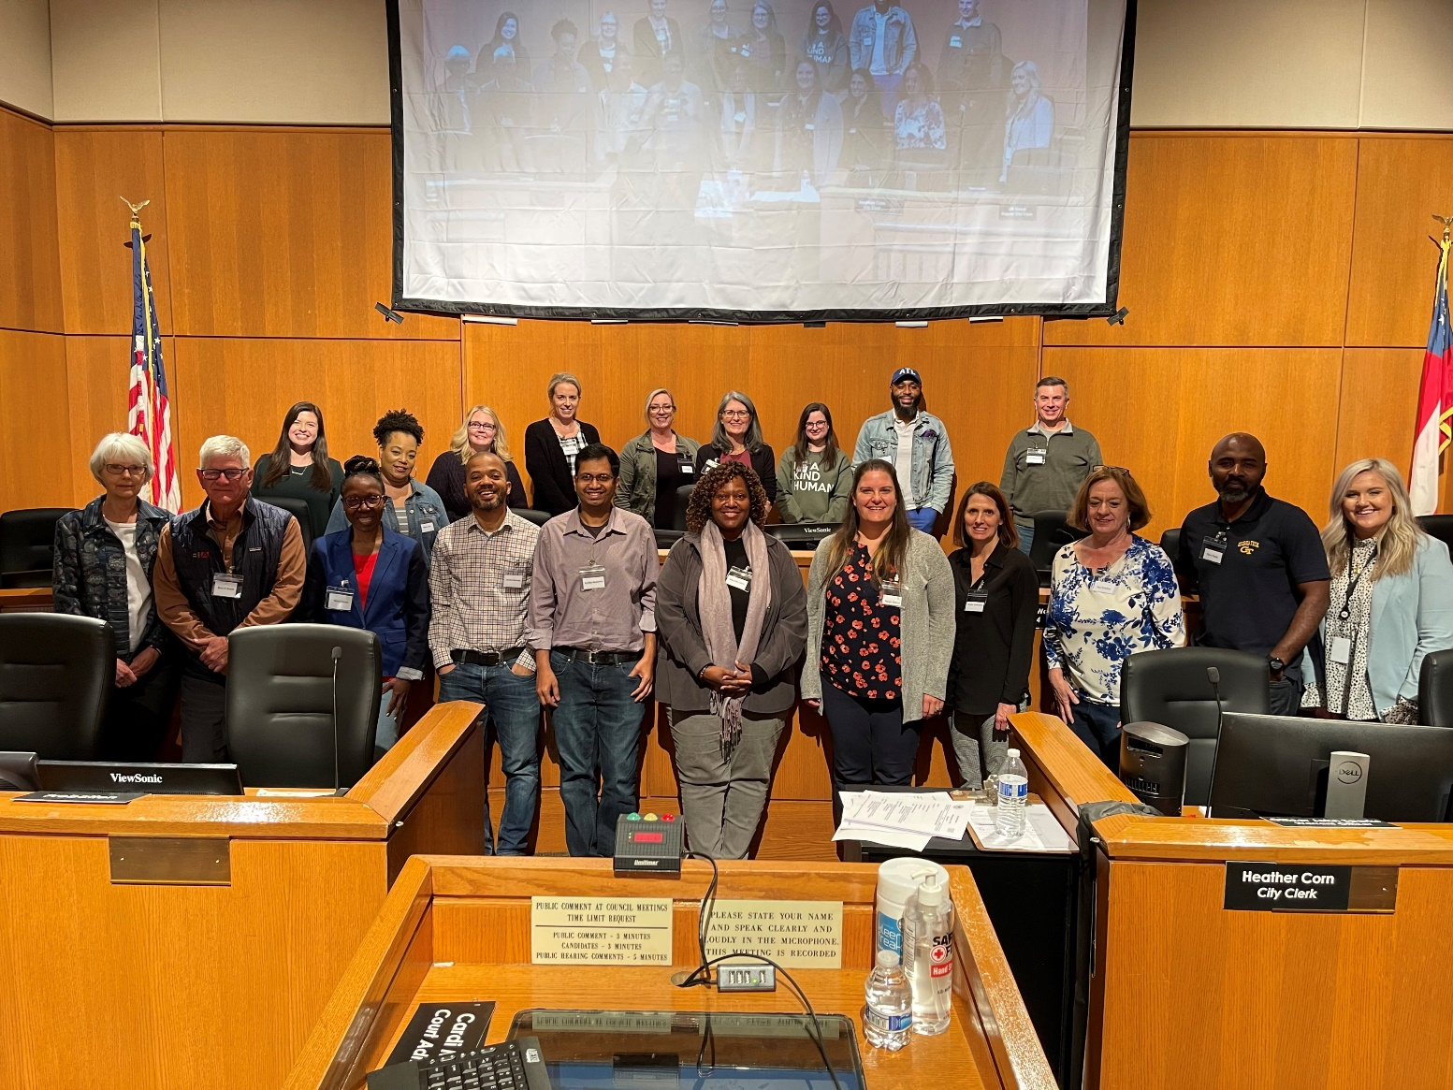
03.15 City Council & Administration

Slide 3
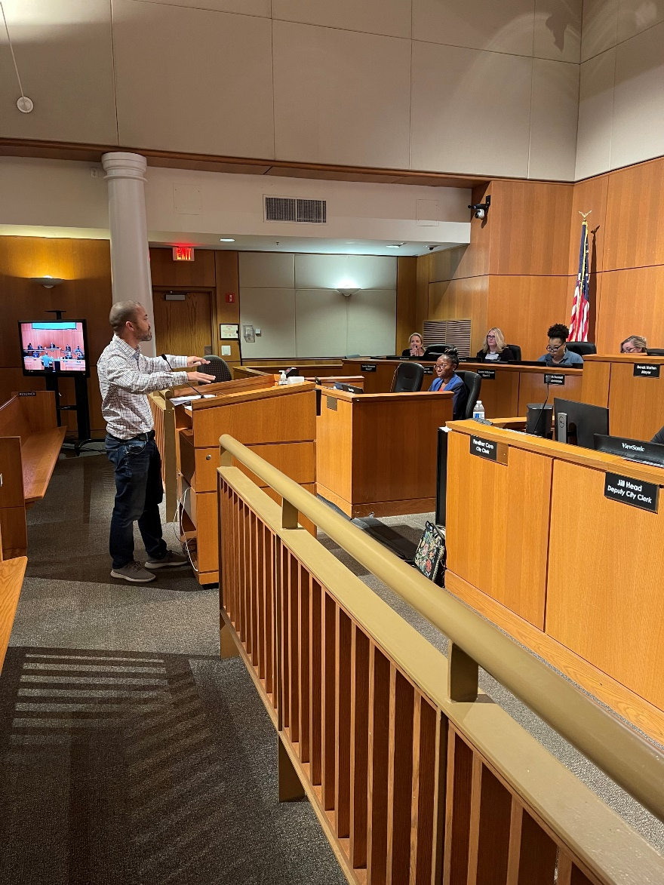
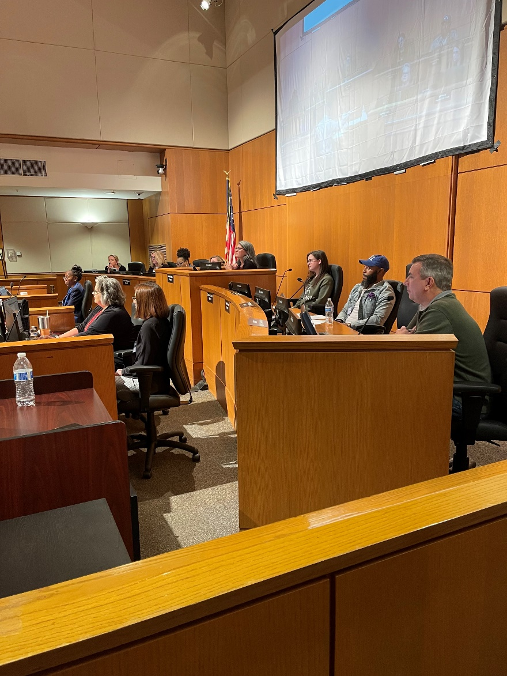
03.15 City Council & Administration

Slide 4
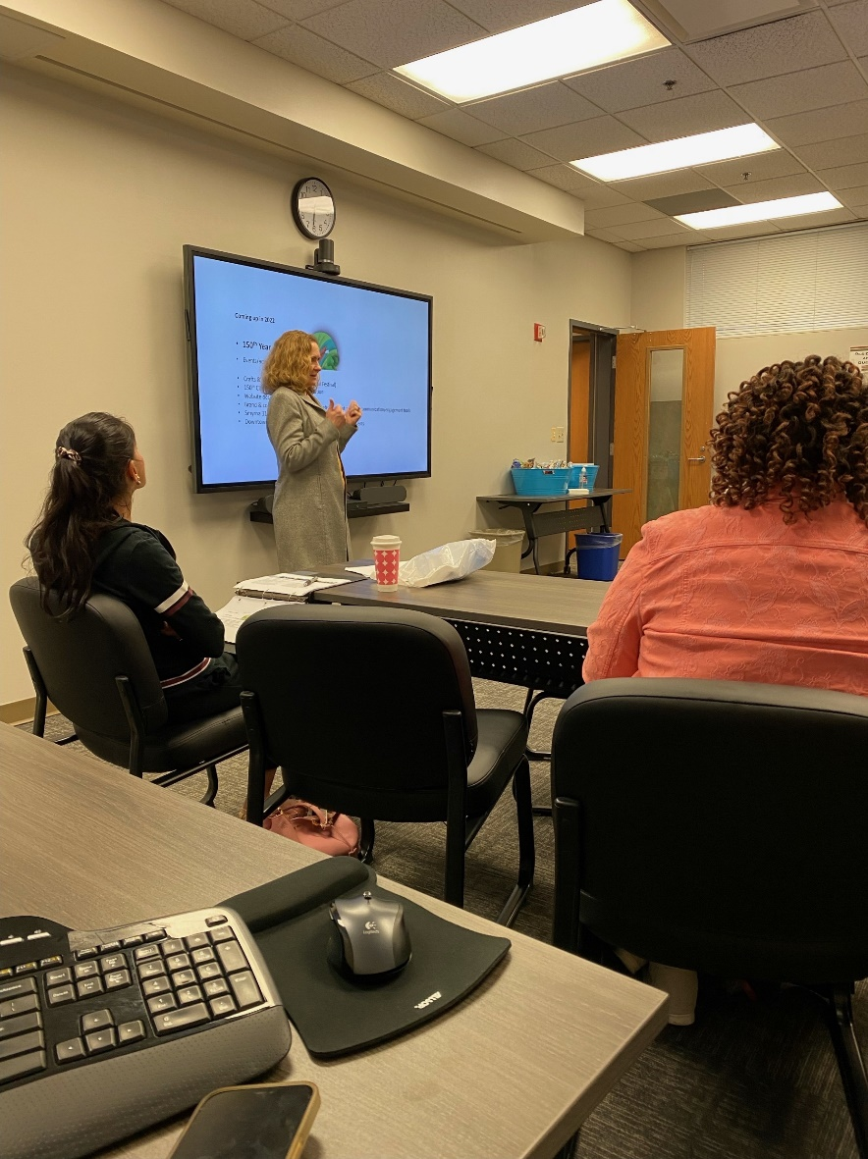
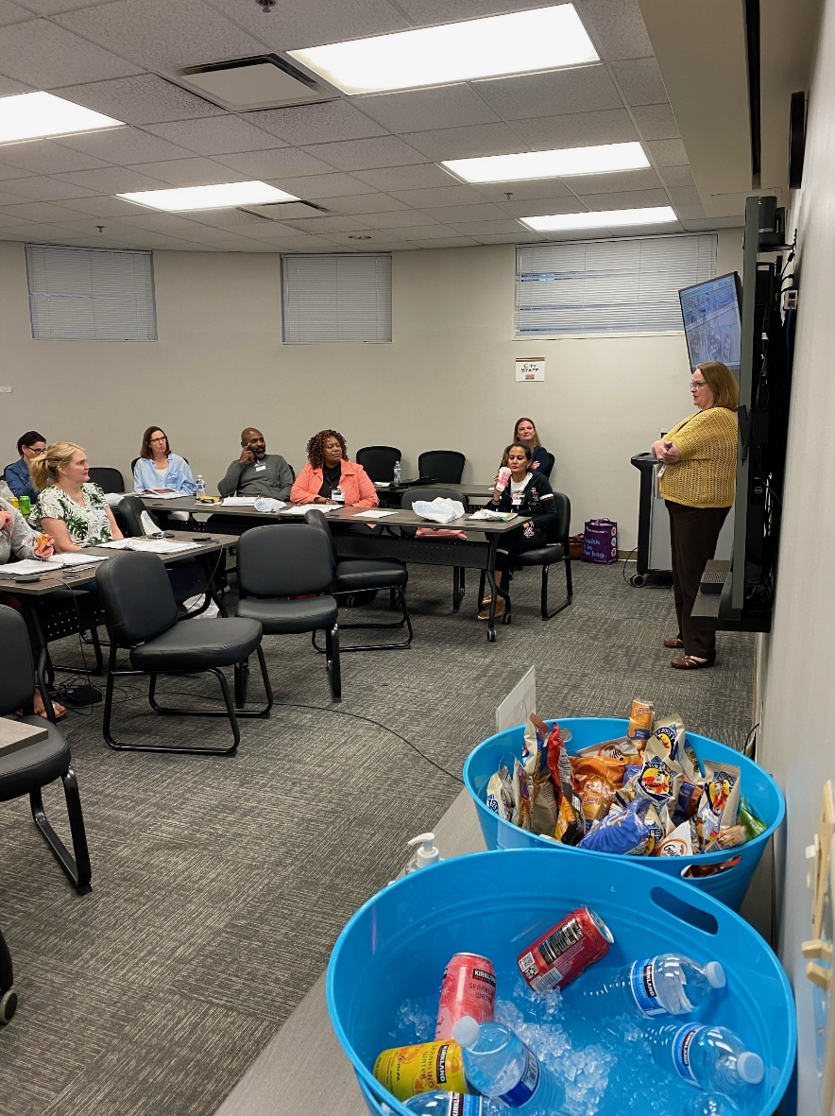
03.22 Finance, HR & Community Relations

Slide 5
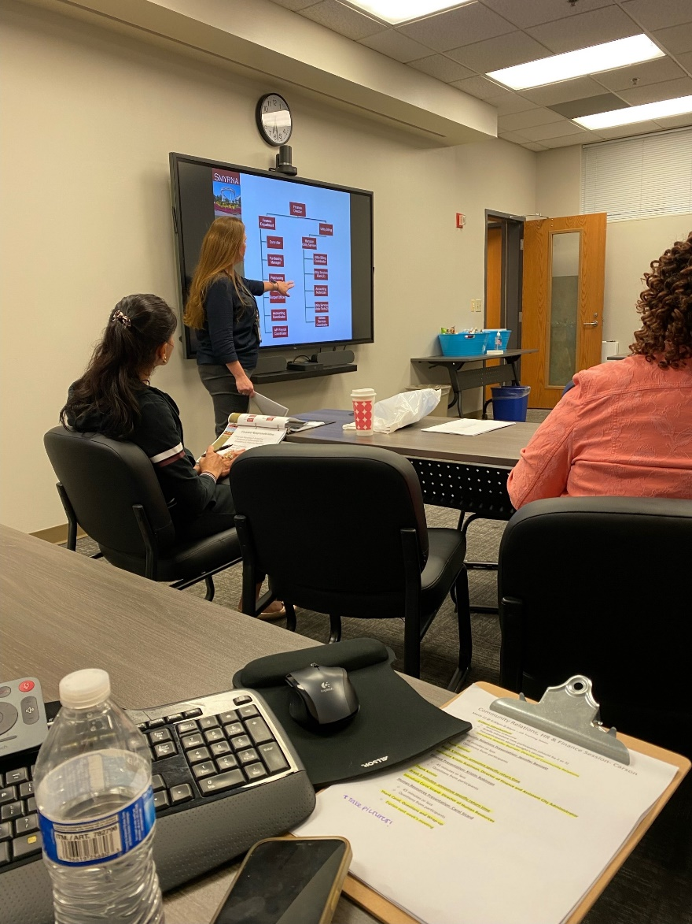
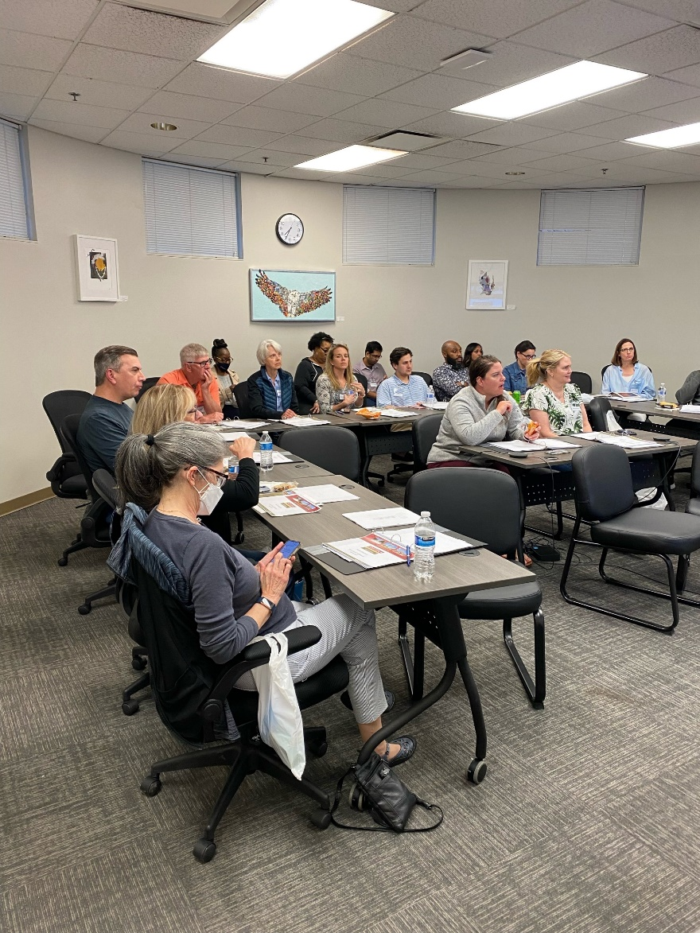
03.22 Finance, HR & Community Relations

Slide 6
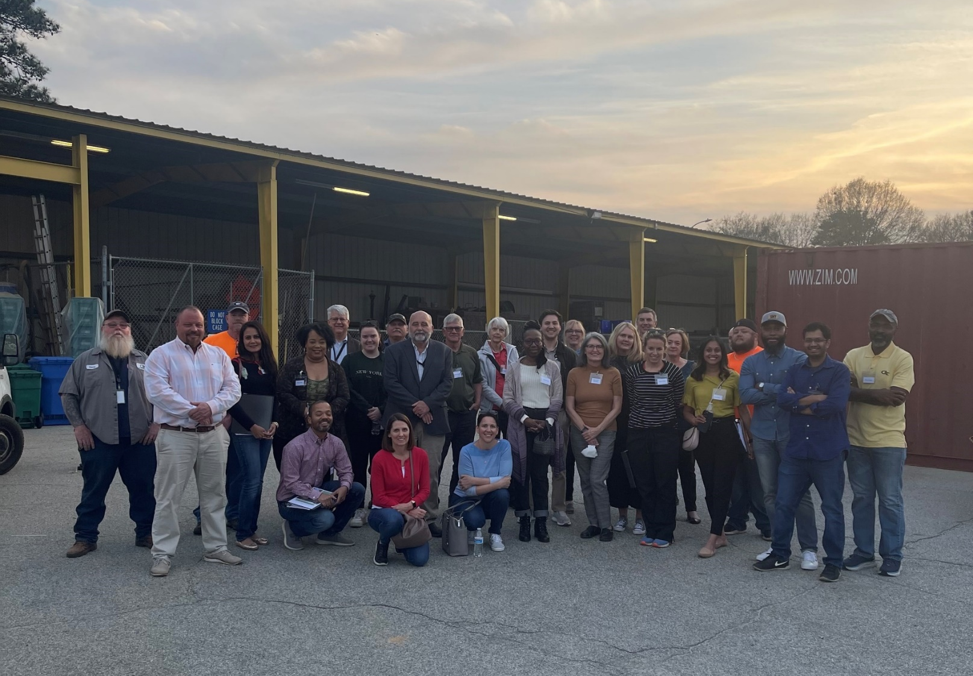
03.29 Public Works & Engineering

Slide 7
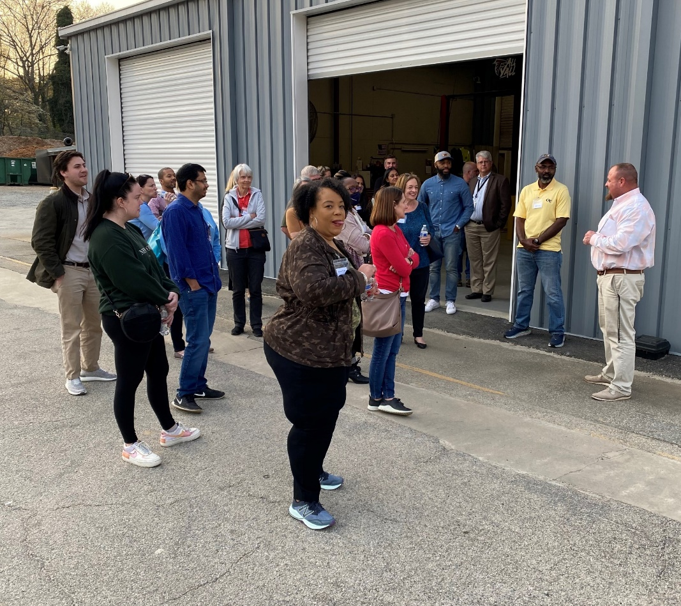
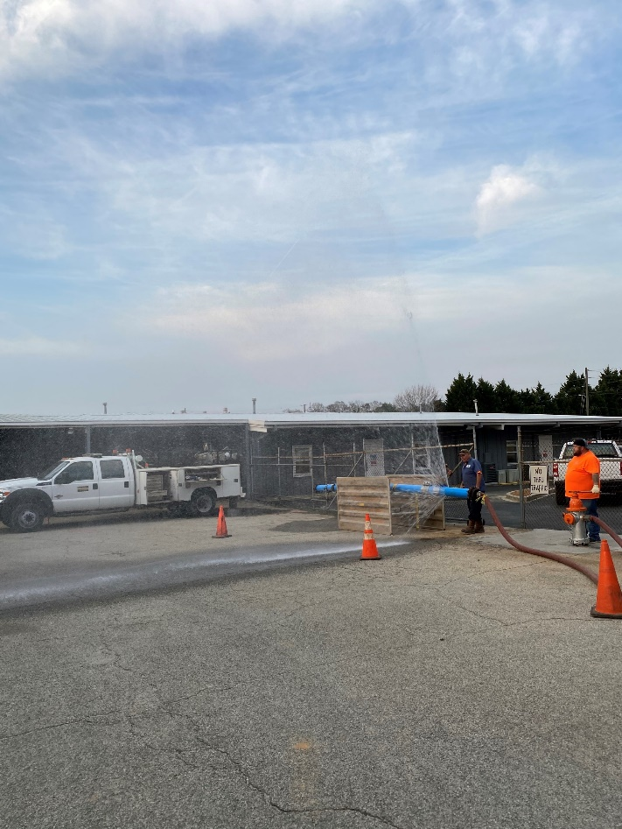
03.29 Public Works & Engineering

Slide 8
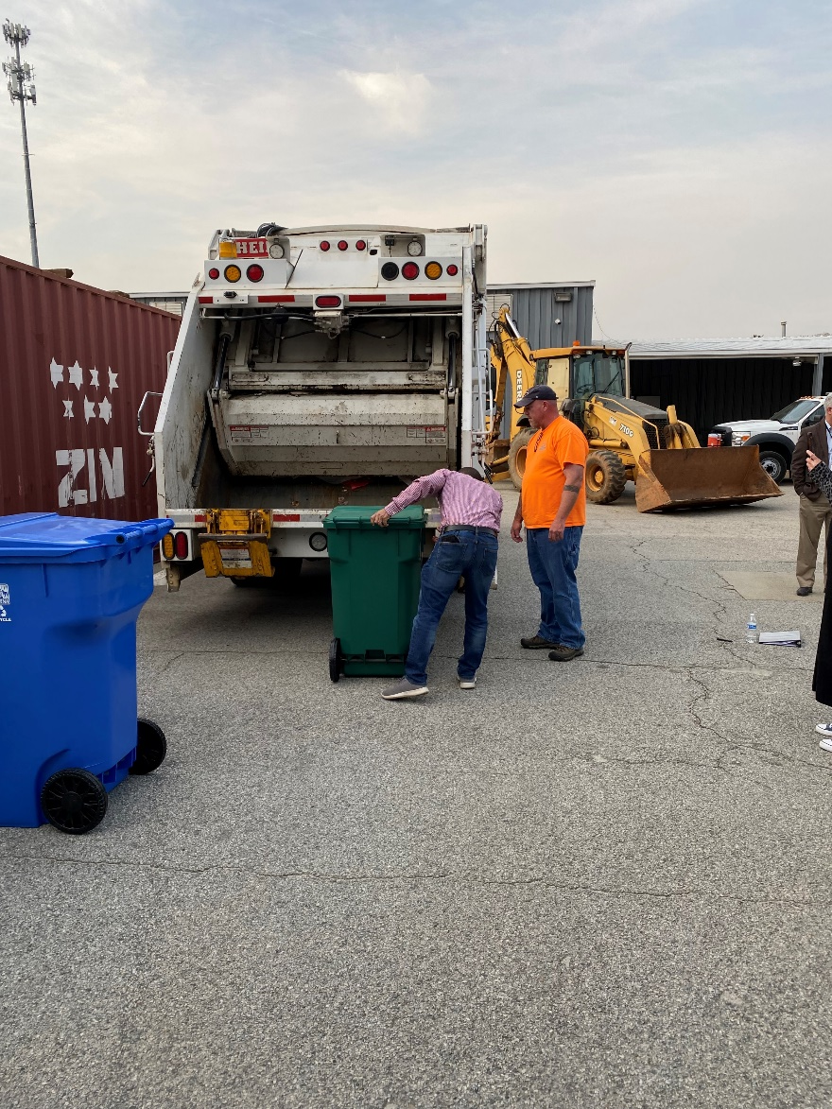
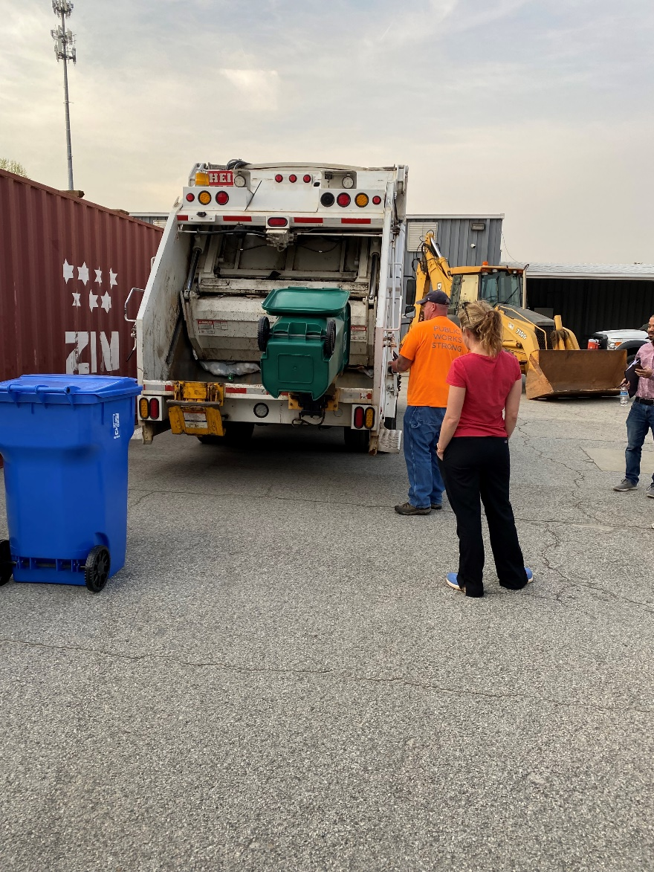
03.29 Public Works & Engineering

Slide 9
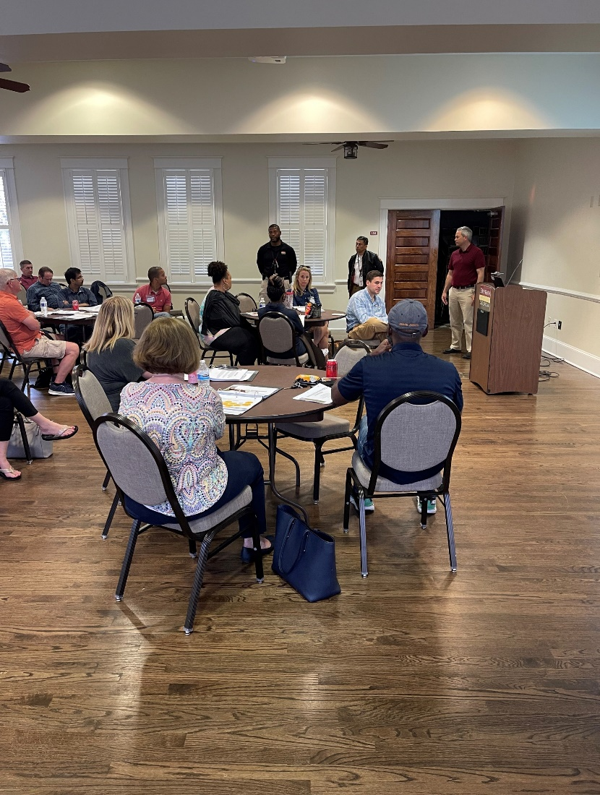
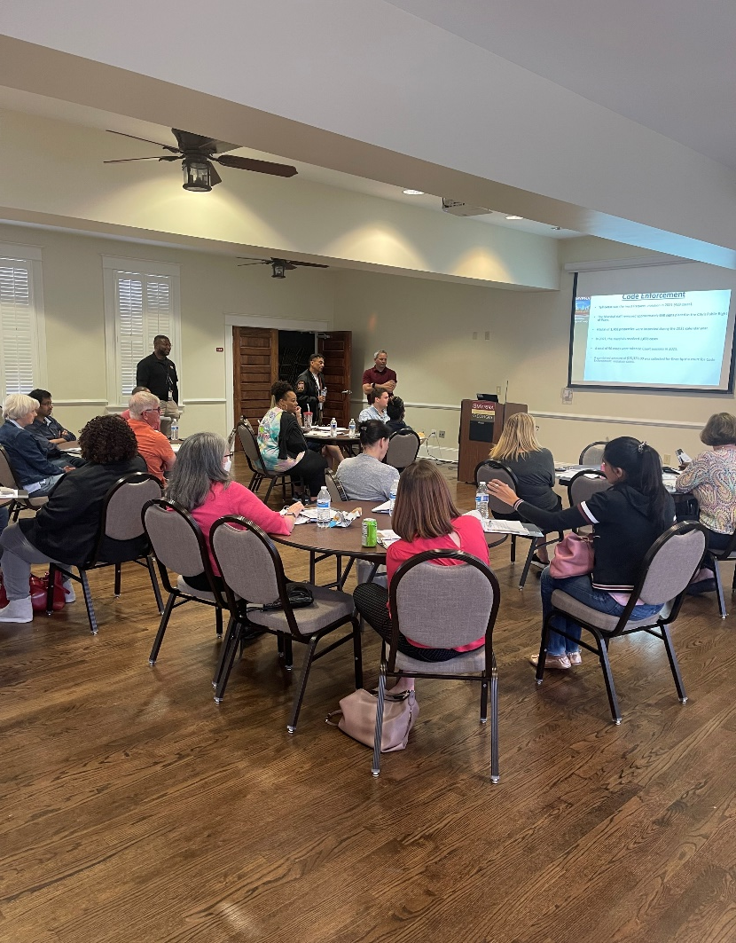
04.12 Community Development, Economic Development & IT

Slide 10
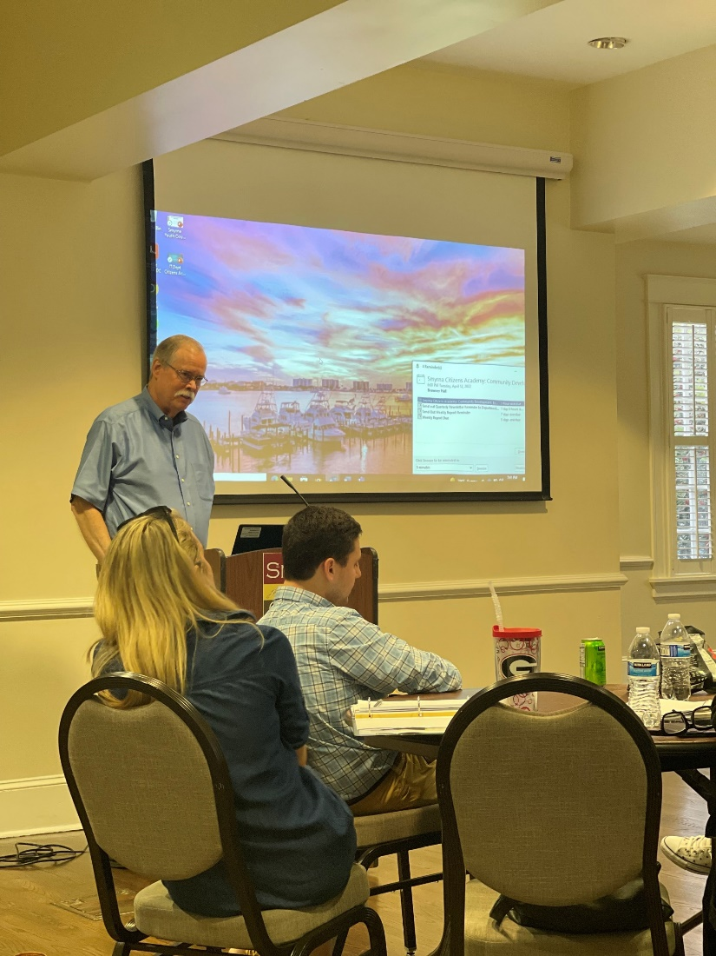
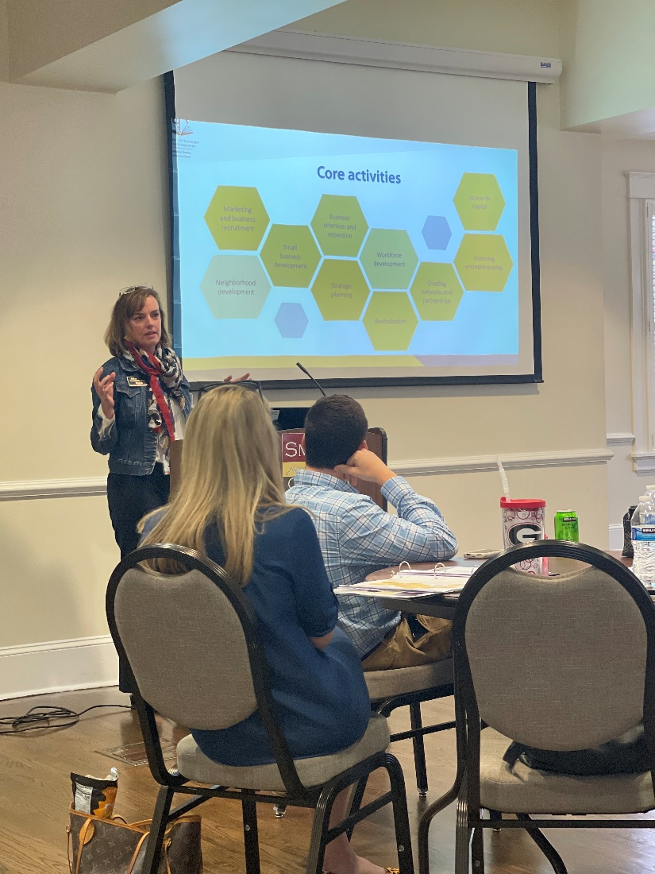
04.12 Community Development, Economic Development & IT

Slide 11
04.19 Environmental Services/ KSB

